Slide 1
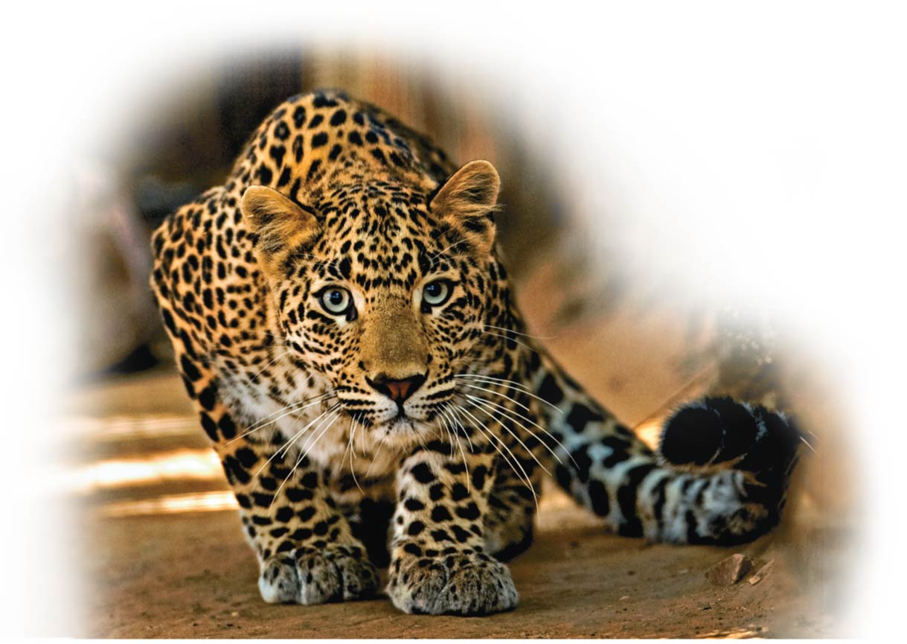
A Tour of the Cell
Unit 1; Chapter 4

Slide 2
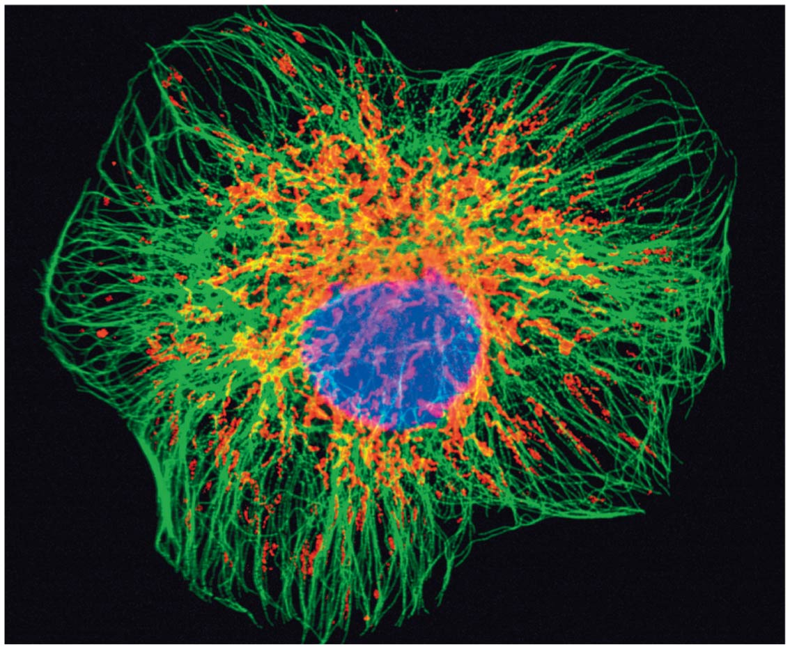
Notes:
Figure 4.0-1ba Why cells matter (part 2a: cytoskeleton, micrograph)

Slide 3
Biology and Society Antibiotics: Drugs That Target Bacterial Cells
The first antibiotic（抗生素） to be discovered was penicillin in 1920.
The widespread use of antibiotics drastically decreased deaths from bacterial infections.
Notes:
3

Slide 4
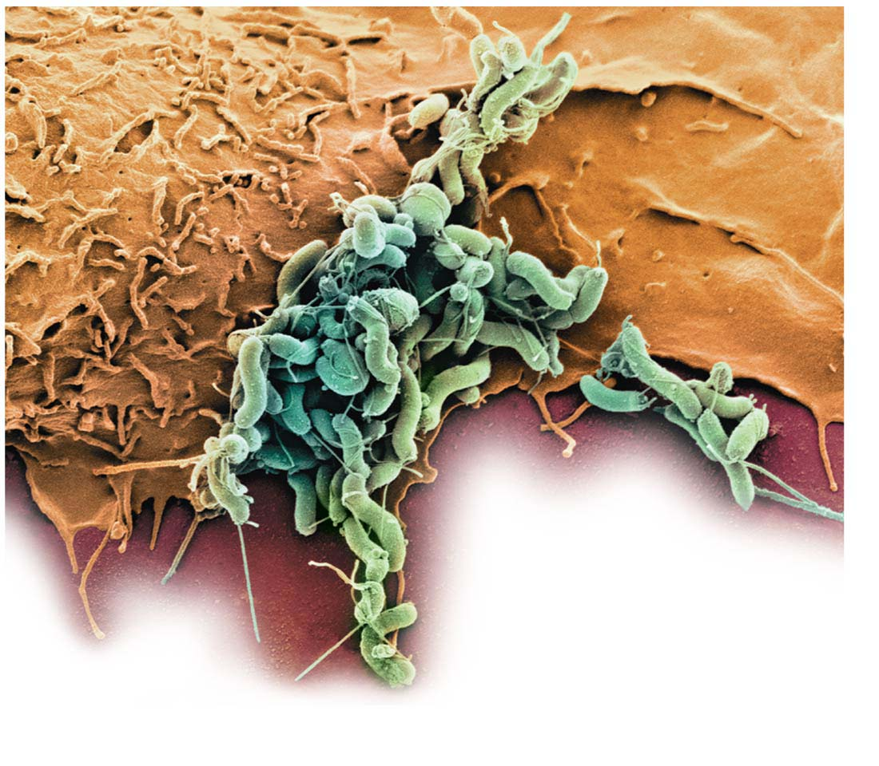
Colorized TEM
Helicobacter pylori
（幽门螺旋菌）
Notes:
Figure 4.0-2 Humans versus bacteria: two kinds of cells

Slide 5
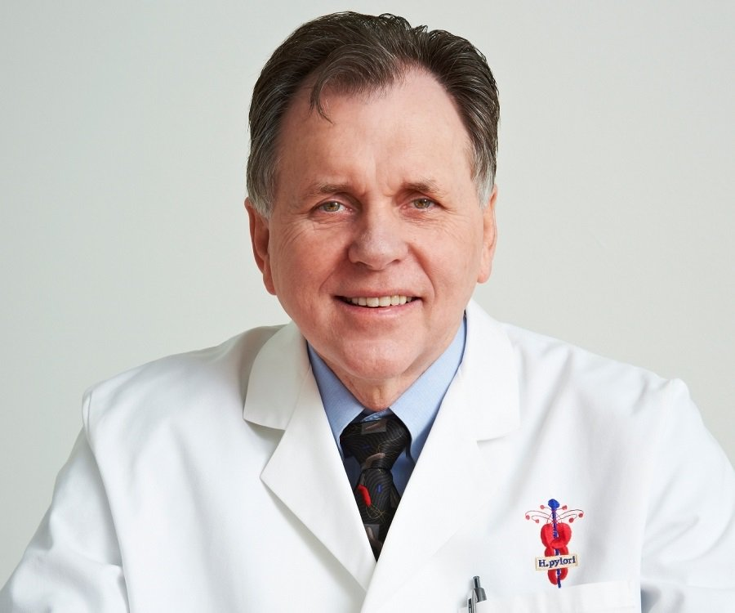
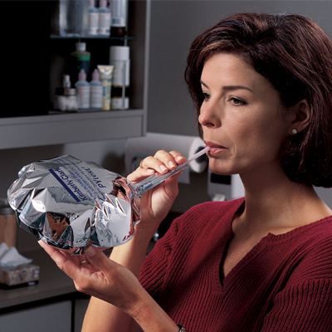
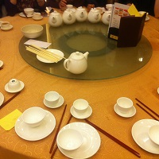
Diagnosis- C13/C14 Breath Test
Barry Marshall, 2005 Nobel Prize in medicine
Serving Utensils

Slide 6
Biology and Society Antibiotics: Drugs That Target Bacterial Cells
Most antibiotics bind to structures found only in bacterial cells.
Some antibiotics bind to the bacterial ribosome（核糖体），leaving human ribosomes unaffected.
Other antibiotics target enzymes found only in the bacterial cells.
Notes:
6

Slide 7
The Microscopic World of Cells
Organisms are either
single-celled, such as most prokaryotes（原核生物） and protists（原生生物） or
multicelled, such as
plants,
animals, and
most fungi（真菌）.
Notes:
7

Slide 8
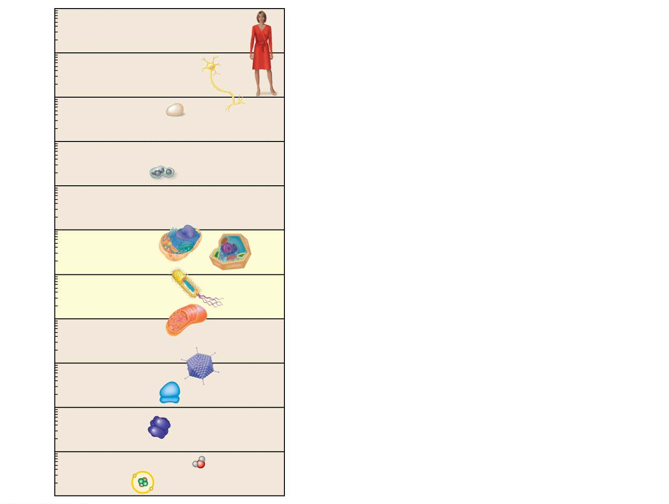
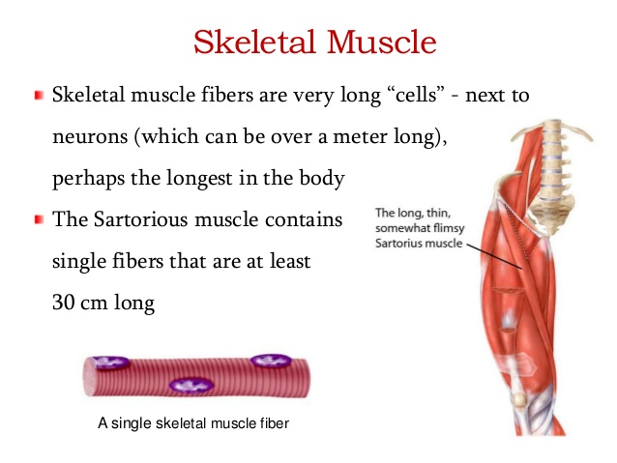
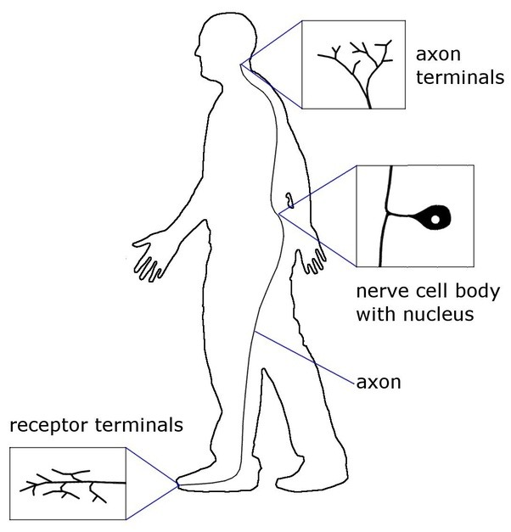
10 m
The size range of cells compared with objects both larger and smaller.
1 m
Human height
Length of some
nerve and muscle
cells
10 cm
Chicken egg
Visible with
the naked eye
1 cm
Frog eggs
1 mm
100 μm
Plant and
animal cells
10 μm
Nuclei
Most bacteria
1 μm
Mitochondria
Measurement Equivalents
Smallest
bacteria
1 meter (m) = 100 cm = 1,000 mm = about 39.4 inches
100 nm
Viruses
1 centimeter (cm) = 10⁻²
1
m = about 0.4 inch
Ribosomes
100
10 nm
1
1
Proteins
1 millimeter (mm) = 10⁻³
1,000
m =
10
cm
Lipids
1 nm
Small molecules
1 micrometer (μm) = 10⁻⁶ m = 10⁻³ mm
0.1 nm
Atoms
1 nanometer (nm) = 10⁻⁹ m = 10⁻³ µm
Notes:
Figure 4.1 The size range of cells

Slide 9
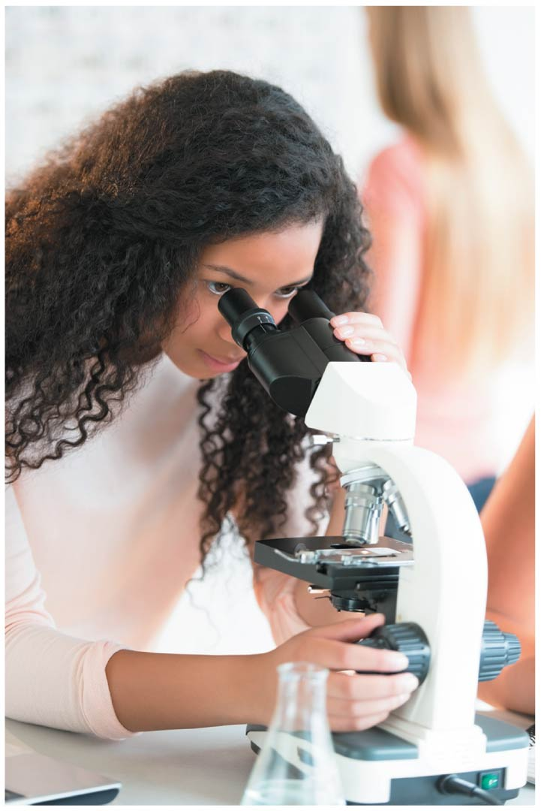
Notes:
Figure 4.1-4 The size range of cells (part 4: photo)

Slide 10
The Microscopic World of Cells
Cell theory states that all living things are composed of cells and that all cells come from earlier cells.
So every cell in your body (and in every other living organism on Earth) was formed by division of a previously living cell.
Notes:
10

Slide 11
The Two Major Categories of Cells
The countless cells on Earth fall into two basic categories.
Prokaryotic cells（原核细胞） include
Bacteria and
Archaea（古生菌）.
Eukaryotic cells（真核细胞） include
protists,
plants,
fungi, and
animals.
Notes:
11
Student Misconceptions and Concerns
1. Students frequently equate the functions of mitochondria and chloroplasts as alternative ways to acquire usable energy. This often leads to the conclusion that animal cells have mitochondria but not chloroplasts and that plant cells have chloroplasts but not mitochondria. Plant cells have both.
Teaching Tips
1. Even in college, students still struggle with the metric system. When discussing the scale of life, consider bringing a meter stick to class. The ratio of a meter to a millimeter is the same as the ratio of a millimeter to a micron: 1 to 1000.
2. This is a place where a visual image comparing a prokaryotic and eukaryotic cell can be very helpful. These cells are strikingly different in size and composition. A visual reference point instead of just abstract ideas and traits will be a continual reminder for your students during your discussion of these cells.
3. Students might wrongly conclude that prokaryotes are typically one-tenth the volume of eukaryotic cells. A difference in diameter by a factor of ten translates into a much greater difference in volume. Students might be challenged to recall enough geometry to calculate the difference in the volume of two cells with diameters that differ by a factor of ten.
4. Some instructors have reported great success by challenging their students to make analogies to the functions of the many organelles discussed. Students may wish to construct one inclusive analogy between a society or factory (used in the text) and a cell or to construct separate analogies for each organelle. As with any analogy, it is important to list the similarities and differences/exceptions.
5. This might be a good time to discuss the evolution of antibiotic resistance. Teaching tips and ideas for related lessons can be found at www.pbs.org/wgbh/evolution/educators/lessons/lesson6/act1.html.
Active Lecture Tips
1. Germs—here is a term that we learn early in our lives but that is rarely well defined. Ask students to work in pairs to illustrate examples of “germs.” Students may appreciate a biological explanation. The general use of germs is a reference to anything microscopic that causes disease. This may be a good time to sort the major disease-causing agents into three categories: (a) bacteria (prokaryotes), (b) viruses (not yet addressed), and (c) single-celled and multicellular eukaryotes (athlete’s foot is a fungal infection; malaria is caused by a unicellular eukaryote).

Slide 12
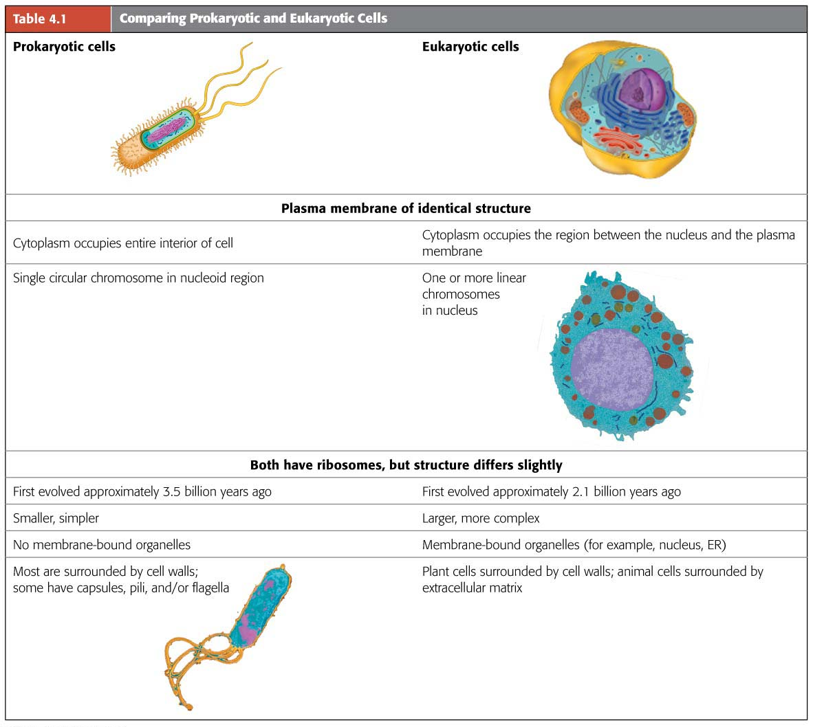
Cytosol
Chromosomes
Nucleoid
carrying genes made of DNA
Nucleus
Notes:
Table 4.1 Comparing prokaryotic and eukaryotic cells

Slide 13
The Two Major Categories of Cells
All cells have several basic features.
They are all bounded by a thin plasma membrane（细胞质膜）.
Inside all cells is a thick, jelly-like fluid called the cytosol, in which cellular components are suspended.
All cells have one or more chromosomes（染色体） carrying genes made of DNA.
All cells have ribosomes, tiny structures that build proteins according to the instructions from the genes.
Notes:
13

Slide 14
The Two Major Categories of Cells
Prokaryotic cells are older than eukaryotic cells.
Prokaryotes appeared about 3.5 billion years ago.
Eukaryotes appeared about 2.1 billion years ago.
Prokaryotic cells are
usually smaller than eukaryotic cells and
simpler in structure.
Notes:
14

Slide 15
The Two Major Categories of Cells
Eukaryotic cells
Only eukaryotic cells have organelles（细胞器）, membrane-enclosed structures that perform specific functions.
The most important organelle is the nucleus（细胞核）, which houses most of a eukaryotic cell’s DNA and is surrounded by a double membrane.
A prokaryotic cell lacks a nucleus. Its DNA is coiled into a nucleus-like region called the nucleoid（拟核）.
Notes:
15

Slide 16
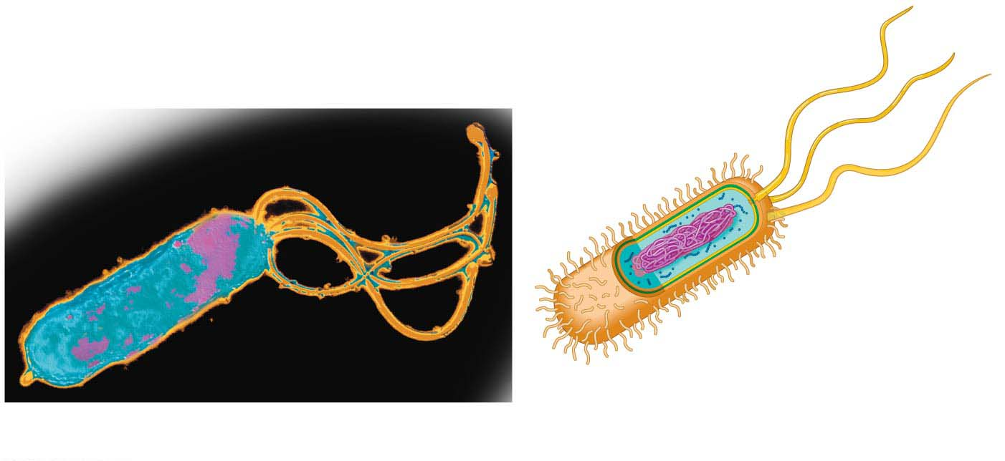
A prokaryotic cell
Plasma membrane
(encloses cytoplasm)
Cell wall
(provides rigidity)
Capsule
(sticky
coating)
Flagella
(for propulsion)
Ribosomes
(synthesize proteins)
Colorized TEM
Nucleoid (contains
single circular bacterial
chromosome)
Pili (attachment
structures)

Slide 17
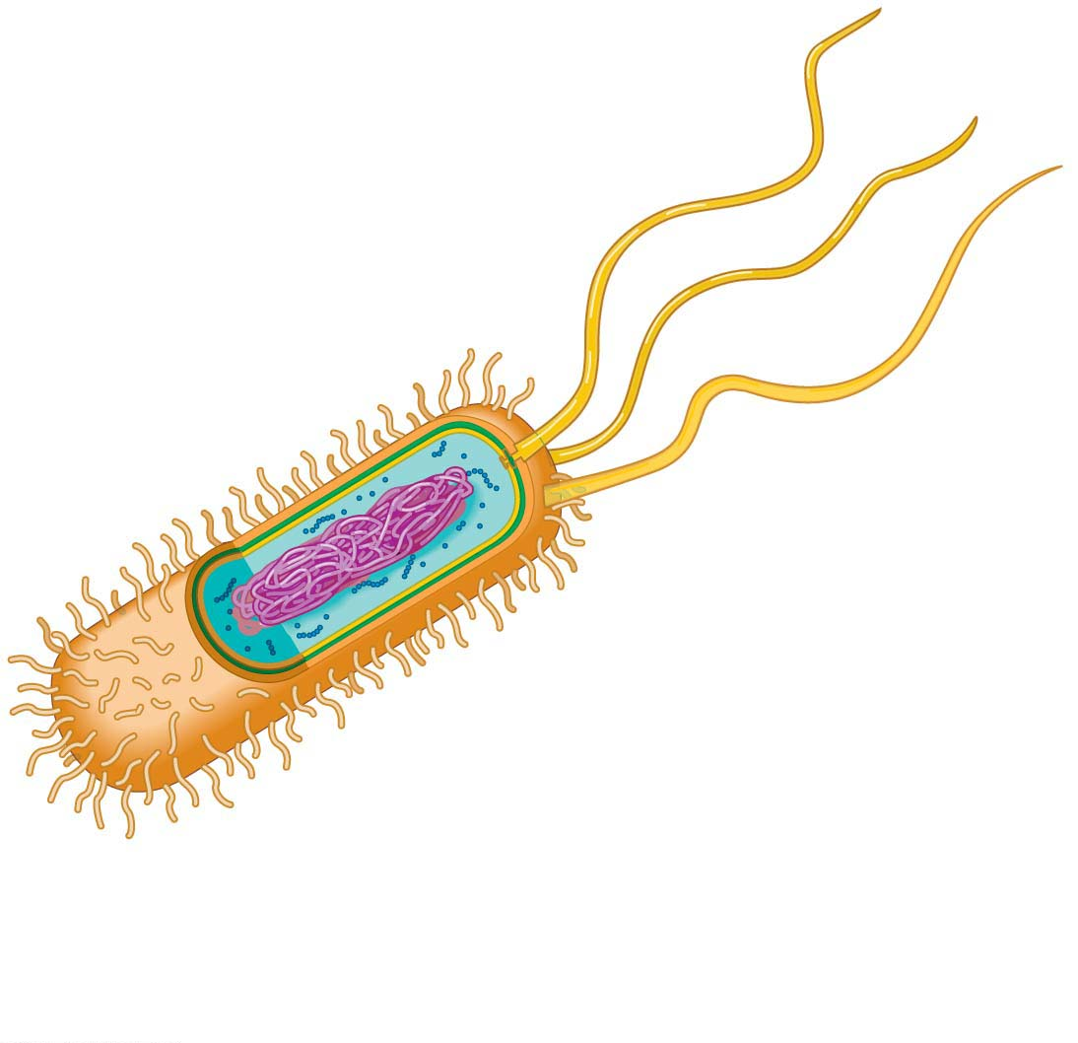
Plasma membrane
(encloses cytoplasm)
Cell wall
(provides rigidity)
Capsule
(sticky
coating)
Flagella
(for propulsion)
Ribosomes
(synthesize proteins)
Nucleoid (contains
single circular bacterial
chromosome)
Pili (attachment
structures)
（Pili：菌毛；Flagella：鞭毛）

Slide 18
The Two Major Categories of Cells
Surrounding the plasma membrane of most prokaryotic cells is a rigid cell wall, which
protects the cell and
helps maintain its shape.
Prokaryotes can have
short projections called pili, which can also attach to surfaces, and/or
flagella, long projections that propel them through their liquid environment.
flagell = whip (flagellum: a long, whip like cellular appendage that moves cells)
Notes:
18

Slide 19

Video: Prokaryotic Flagella (Salmonella typhimurium)

Slide 20
An Overview of Eukaryotic Cells
Eukaryotic cells are fundamentally similar.
The region between the nucleus and plasma membrane is the cytoplasm.
The cytoplasm of a eukaryotic cell consists of various organelles suspended in the liquid cytosol.
cyto = cell (cytoplasm: cell region between the nucleus and the plasma membrane)
Notes:
20

Slide 21
An Overview of Eukaryotic Cells
Most organelles are found in both animal and plant cells. But there are some important differences.
Only plant cells have chloroplasts（叶绿体） (where photosynthesis（光合作用） occurs).
Only animal cells have lysosomes（溶酶体） (bubbles of digestive enzymes surrounded by membranes).
Notes:
21

Slide 22
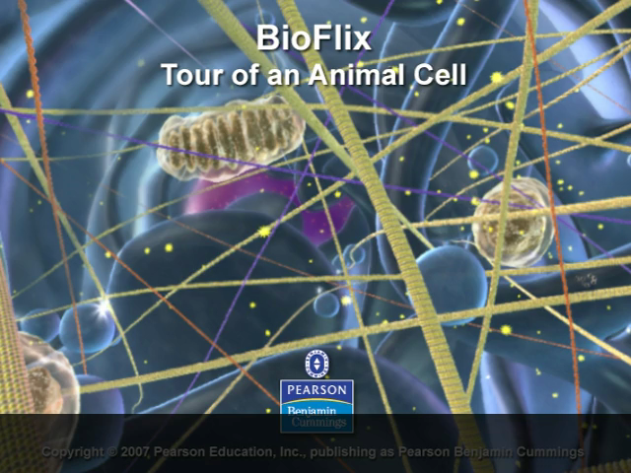
BioFlix Animation: Tour of an Animal Cell

Slide 23
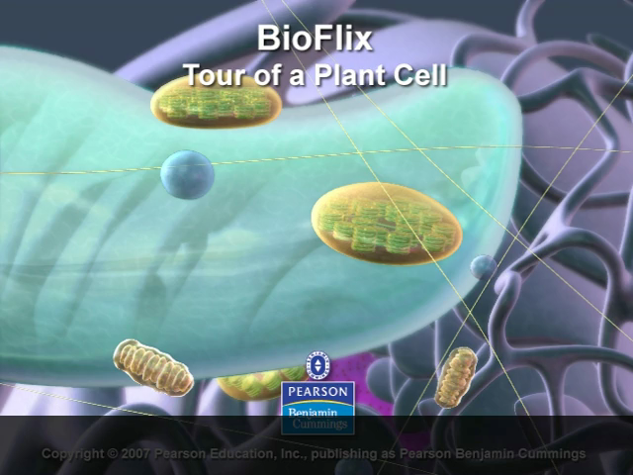
BioFlix Animation: Tour of a Plant Cell

Slide 24
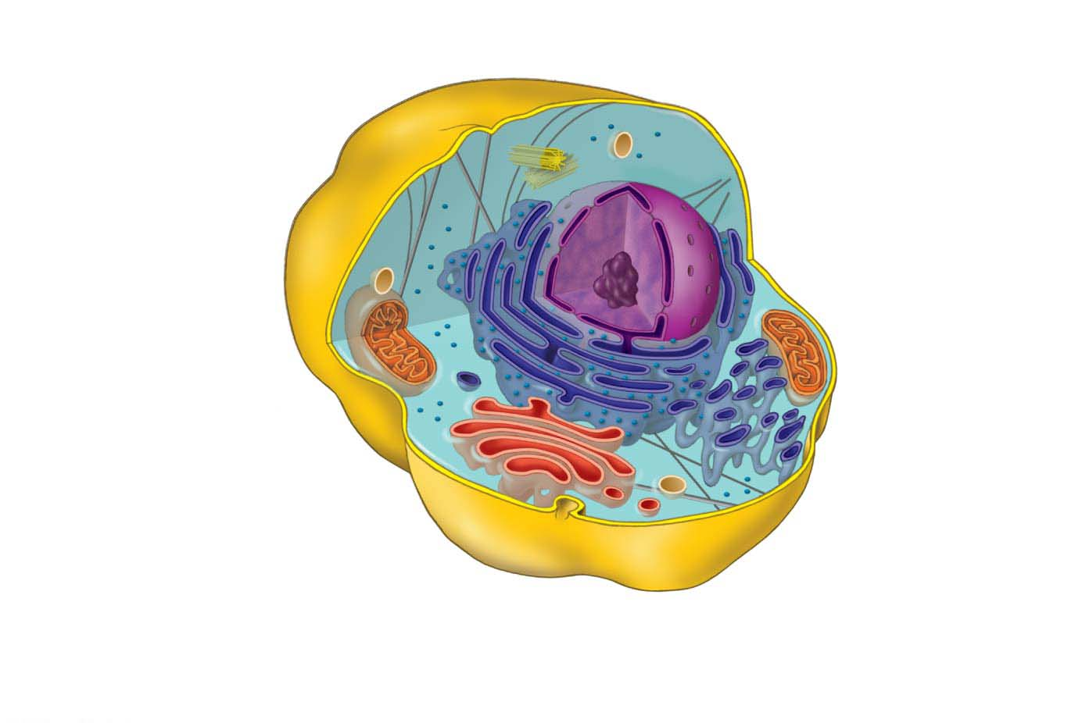
AN IDEALIZED ANIMAL CELL
Centriole
Ribosomes
Lysosome
Cytoskeleton
Plasma
membrane
Nucleus
Cytoplasm
Mitochondrion
Rough endoplasmic
reticulum (ER)
Smooth
endoplasmic
reticulum (ER)
Golgi
apparatus
Cytoskeleton：细胞骨架
Mitochondrion：线粒体
Endoplasmic Reticulum：内质网
Golgi apparatus：高尔基体
Notes:
Figure 4.3-1 An idealized animal cell and plant cell (part 1: animal cell)

Slide 25
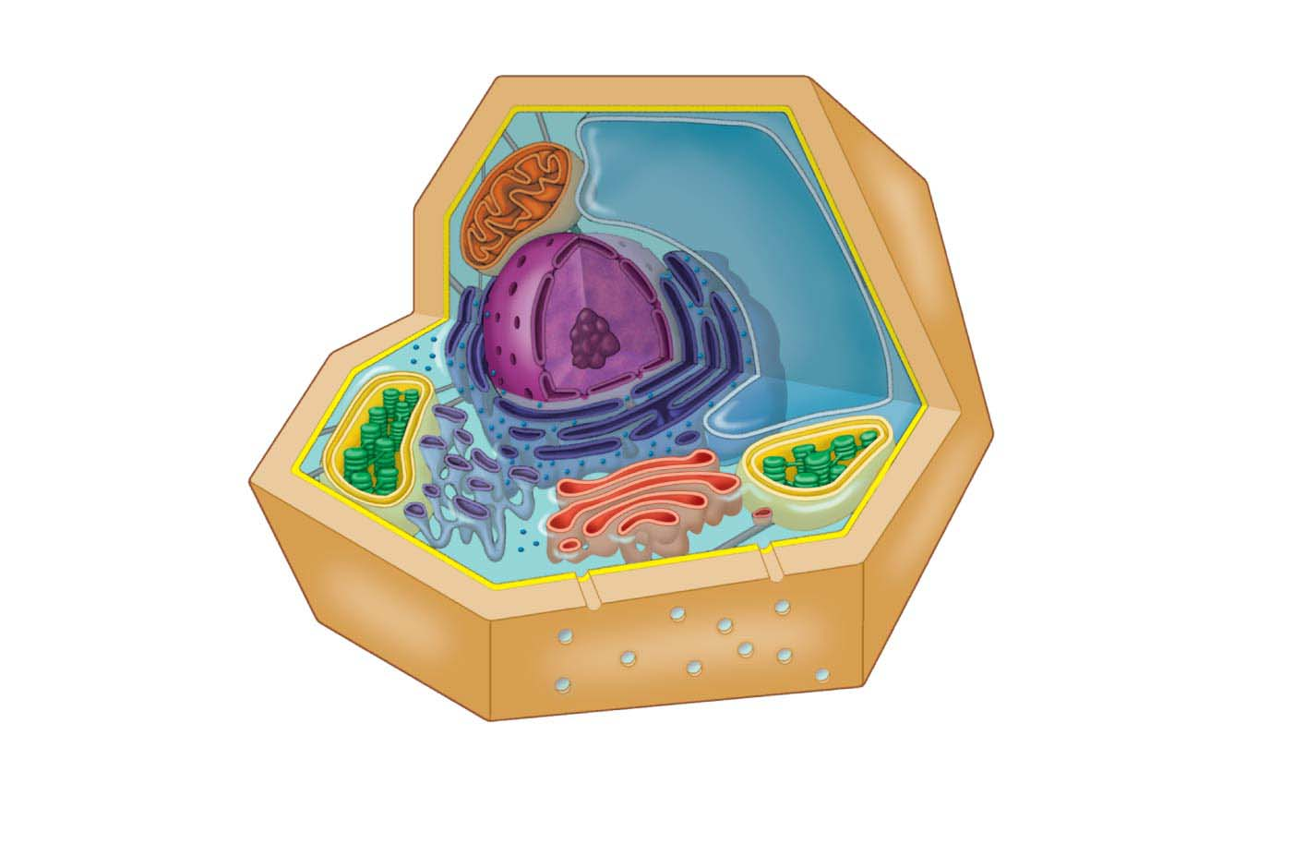
Cytoplasm
Cytoskeleton
（Vacuole: 液泡）
Mitochondrion
Central vacuole
Nucleus
Cell wall
Rough
endoplasmic
reticulum (ER)
Chloroplast
Ribosomes
Plasma
membrane
Smooth
endoplasmic
reticulum (ER)
Channels between
cells
Golgi apparatus
AN IDEALIZED PLANT CELL
Notes:
Figure 4.3-2 An idealized animal cell and plant cell (part 2: plant cell)

Slide 26
Structure/Function: The Plasma Membrane
The plasma membrane and other membranes of the cell are composed mostly of phospholipids（磷脂）, which group together to form a two-layer sheet called a phospholipid bilayer.
Each phospholipid is composed of two distinct regions:
a “head” with a negatively charged phosphate group and
two nonpolar fatty acid “tails.”
Notes:
26

Slide 27
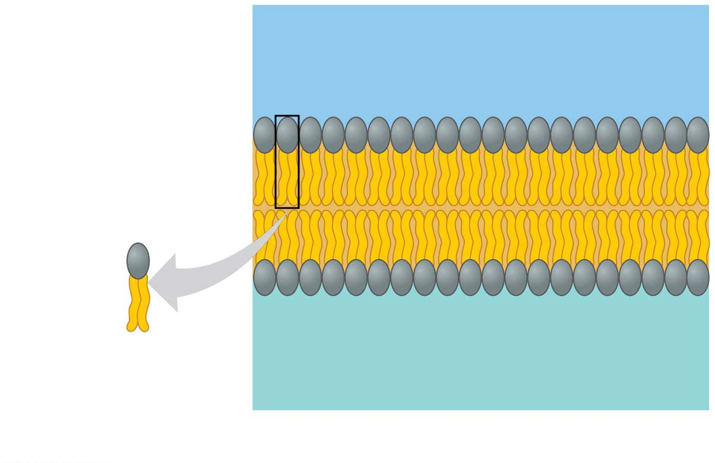
Outside of cell
Hydrophilic（亲水）head
Hydrophobic（疏水）tail
Phospholipid
Cytoplasm (inside of cell)
(a) Phospholipid bilayer of membrane
Notes:
Figure 4.4-1 The plasma membrane structure (part 1: phospholipid bilayer)

Slide 28
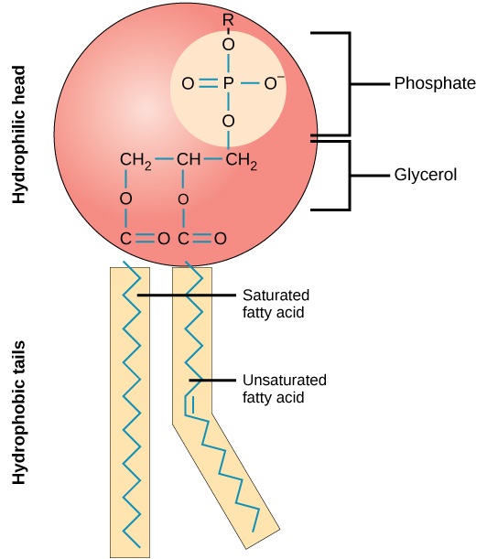

Slide 29
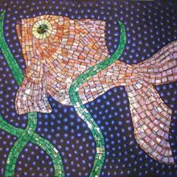
Structure/Function: The Plasma Membrane
Suspended in the phospholipid bilayer of most membranes are proteins that
help regulate traffic across the membrane and
perform other functions.
The plasma membrane is a fluid mosaic（流动镶嵌）:
fluid because molecules can move freely past one another and
a mosaic because of the diversity of proteins in the membrane.
Notes:
29

Slide 30
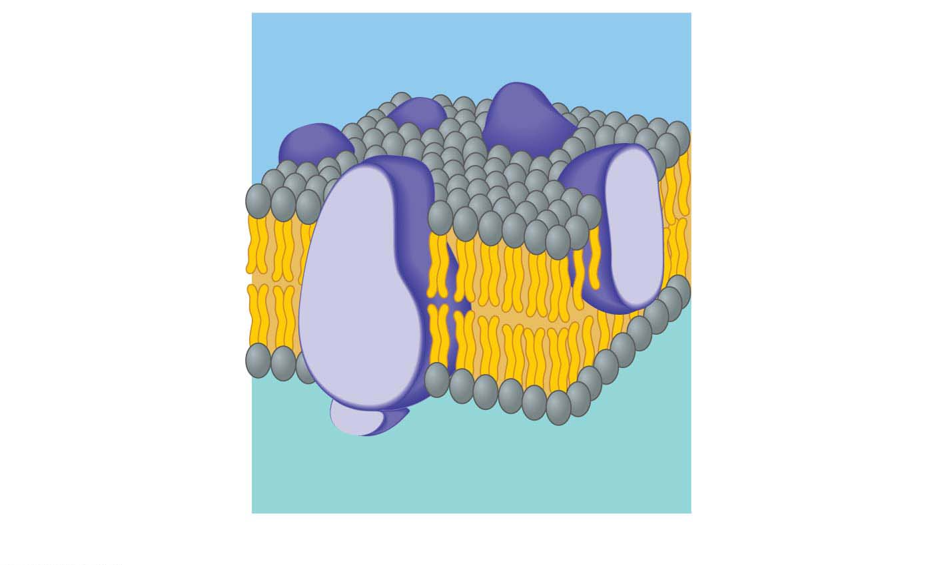
Embedded
proteins
Outside of cell
Phospholipid
bilayer
Hydrophilic
head
Hydrophobic
tail
Cytoplasm (inside of cell)
(b) Fluid mosaic model of membrane
Notes:
Figure 4.4-2 The plasma membrane structure (part 2: fluid mosaic model)

Slide 31
Cell Surfaces
Plant cells have a cell wall made from cellulose fibers（纤维素纤维）.
Plant cell walls
protect the cells,
maintain cell shape, and
keep cells from absorbing too much water.
Animal cells lack cell walls.
Notes:
31

Slide 32
Cell Surfaces
Fibers made of the protein collagen（胶原蛋白）
hold cells together in tissues and
can have protective and supportive functions.
In addition, the surfaces of most animal cells contain cell junctions, structures that connect cells together into tissues, allowing the cells to function in a coordinated way.
Notes:
32

Slide 33
The Nucleus and Ribosomes: Genetic Control of the Cell
The nucleus is the control center of the cell.
Each gene is a stretch of DNA that stores the information necessary to produce a particular protein.
Proteins do most of the actual work of the cell.
Notes:
33
Student Misconceptions and Concerns
1. Students often enter college with misunderstandings about the interrelationship between DNA, a chromosome, and a replicated chromosome often photographed just prior to mitosis or meiosis. Consider specifically distinguishing between these important cellular components early in your discussions of the nucleus.
2. Noting the main flow of genetic information from DNA to RNA to protein on the board will provide a useful reference for students when explaining these processes. As a review, have students note where new molecules of DNA, RNA, and proteins are produced in a cell.
Teaching Tips
1. Some of your more knowledgeable students may like to guess the exceptions to 46 chromosomes per human cell. These exceptions include gametes, some of the cells that produce them, and red blood cells in nonfetal mammals.
2. If you wish to continue the text’s factory analogy, nuclear pores might be said to function most like a door to the boss’s office.
Active Lecture Tips
1. If you want to challenge your students further, ask them to work in pairs or small groups to consider the adaptive advantage of using mRNA to direct the production of proteins instead of using DNA directly. Some biologists suggest that DNA is better protected in the nucleus and that mRNA, exposed to more damaging cross-reactions in the cytosol, is the temporary “working copy” of the genetic material. In some ways, this is similar to making a working photocopy of an important document, keeping the original copy safely stored away.
2. Consider challenging your students to work in pairs or small groups to explain how we can have four main types of organic molecules functioning in specific roles in our cells, yet DNA and RNA only specifically dictate the generation of proteins (and more copies of DNA and RNA). How is the production of specific types of carbohydrates and lipids in cells controlled? (Answer: primarily by the specific properties of enzymes.)

Slide 34
The Nucleus
The nucleus is separated from the cytoplasm by a double membrane called the nuclear envelope（核膜）.
Pores in the envelope allow certain materials to pass between the nucleus and the surrounding cytoplasm.
Notes:
34
Student Misconceptions and Concerns
1. Students often enter college with misunderstandings about the interrelationship between DNA, a chromosome, and a replicated chromosome often photographed just prior to mitosis or meiosis. Consider specifically distinguishing between these important cellular components early in your discussions of the nucleus.
2. Noting the main flow of genetic information from DNA to RNA to protein on the board will provide a useful reference for students when explaining these processes. As a review, have students note where new molecules of DNA, RNA, and proteins are produced in a cell.
Teaching Tips
1. Some of your more knowledgeable students may like to guess the exceptions to 46 chromosomes per human cell. These exceptions include gametes, some of the cells that produce them, and red blood cells in nonfetal mammals.
2. If you wish to continue the text’s factory analogy, nuclear pores might be said to function most like a door to the boss’s office.
Active Lecture Tips
1. If you want to challenge your students further, ask them to work in pairs or small groups to consider the adaptive advantage of using mRNA to direct the production of proteins instead of using DNA directly. Some biologists suggest that DNA is better protected in the nucleus and that mRNA, exposed to more damaging cross-reactions in the cytosol, is the temporary “working copy” of the genetic material. In some ways, this is similar to making a working photocopy of an important document, keeping the original copy safely stored away.
2. Consider challenging your students to work in pairs or small groups to explain how we can have four main types of organic molecules functioning in specific roles in our cells, yet DNA and RNA only specifically dictate the generation of proteins (and more copies of DNA and RNA). How is the production of specific types of carbohydrates and lipids in cells controlled? (Answer: primarily by the specific properties of enzymes.)

Slide 35
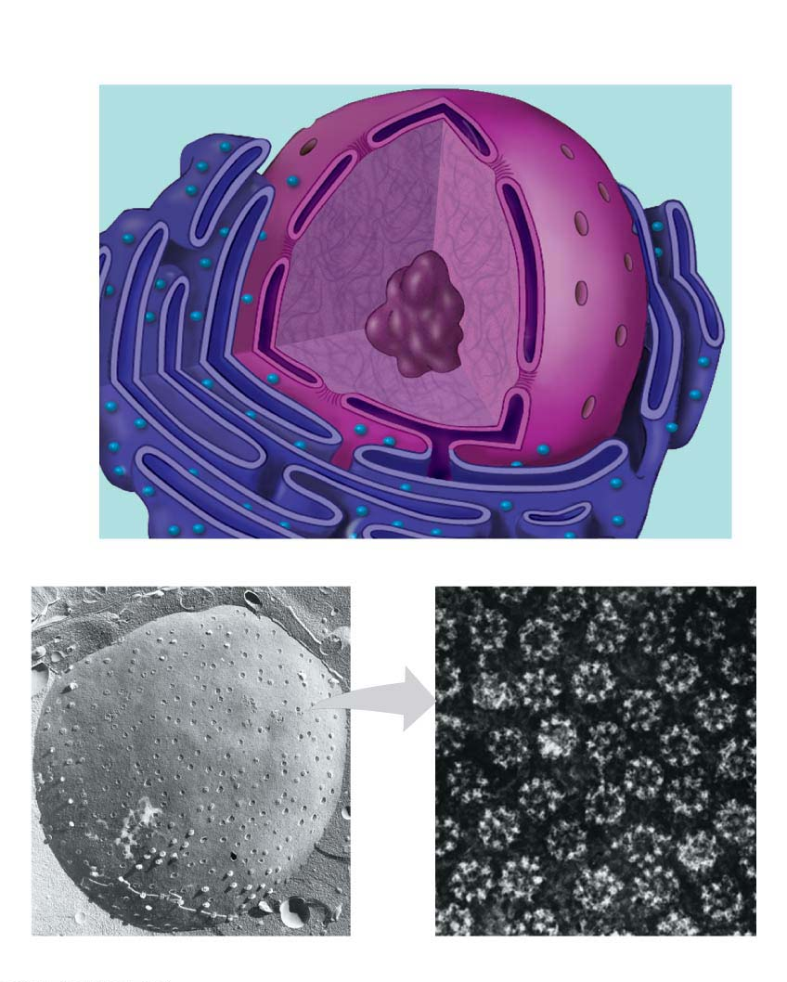
Nuclear
envelope
Nucleolus
Nuclear
pore
Chromatin fiber
TEM
TEM
Surface of nuclear envelope
Nuclear pores
Notes:
Figure 4.6 The nucleus

Slide 36
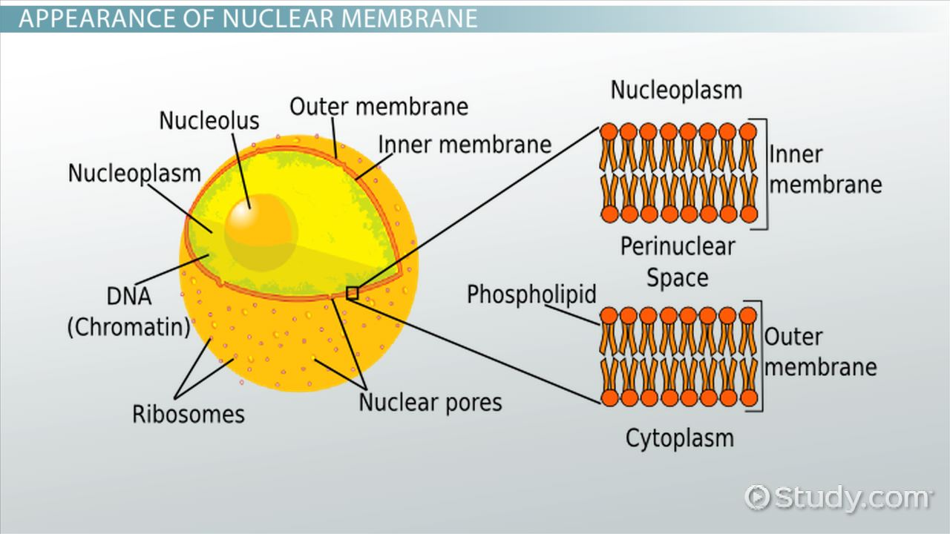

Slide 37
The Nucleus
Within the nucleus, long DNA molecules and associated proteins form fibers called chromatin（染色质）.
Each long chromatin fiber constitutes one chromosome.
The nucleolus（核仁） is
a prominent structure within the nucleus and
the site where the components of ribosomes are made.
Notes:
37

Slide 38
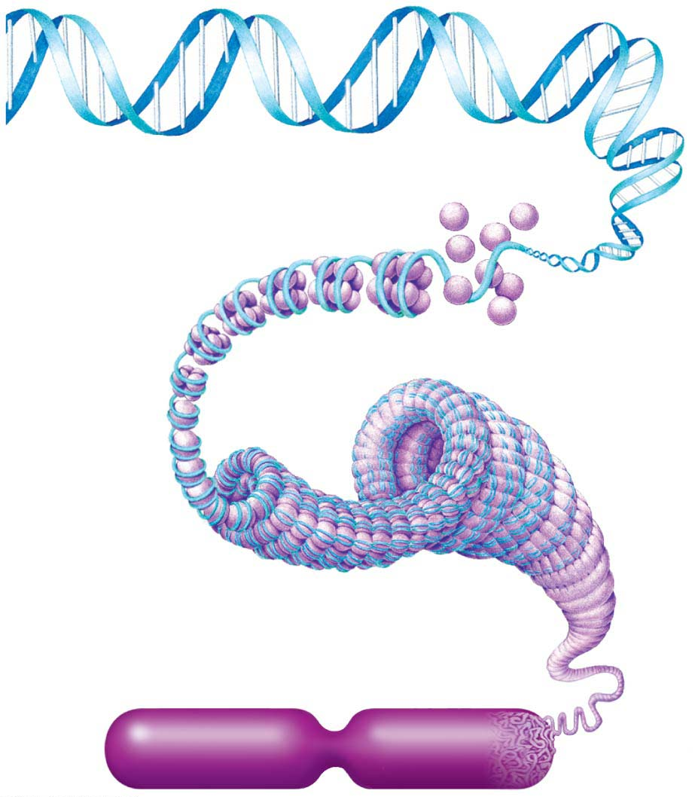
DNA molecule
Proteins
Chromatin
fiber
Chromosome

Slide 39
Ribosomes
Ribosomes are responsible for protein synthesis.
In eukaryotic cells, the components of ribosomes are made in the nucleus and then transported through the pores of the nuclear envelope into the cytoplasm, where ribosomes begin their work.
Notes:
39

Slide 40
Ribosomes
Although structurally identical, some ribosomes are suspended in the cytosol, making proteins that remain within the fluid of the cell.
Others are attached to the outside of the nucleus or an organelle called the endoplasmic reticulum, making proteins that are incorporated into membranes or secreted by the cell.
Notes:
40

Slide 41
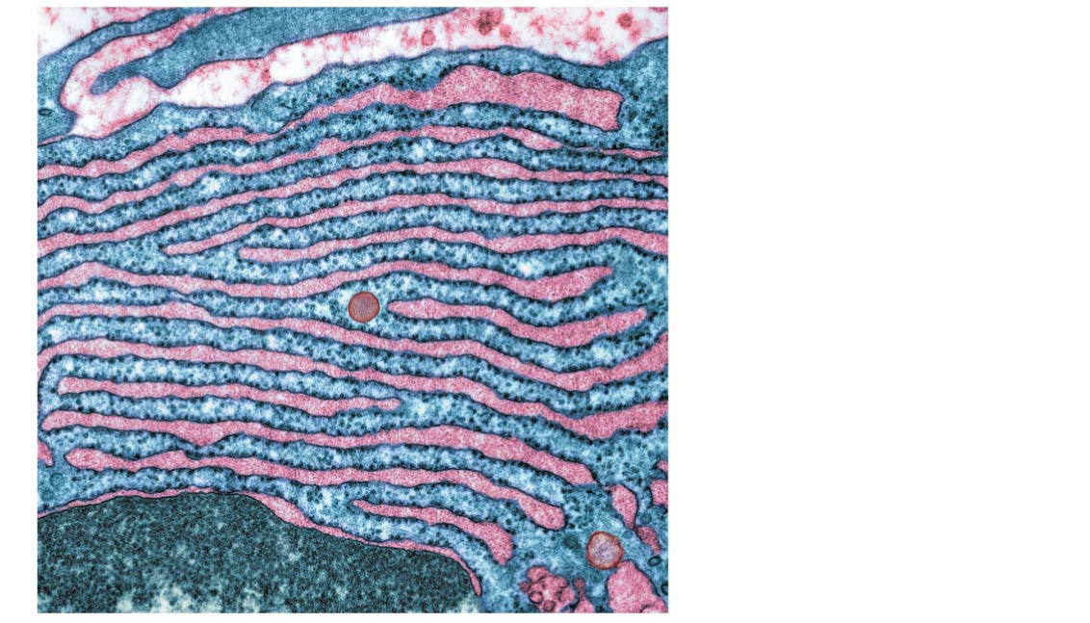
TEM
Ribosomes attached
to endoplasmic
reticulum visible as
tiny dark blue dots

Slide 42
How DNA Directs Protein Production?
DNA transfers its coded information to a molecule called messenger RNA (mRNA).
mRNA
exits the nucleus through pores in the nuclear envelope and
travels to the cytoplasm, where it binds to a ribosome.
A ribosome moves along the mRNA, translating the genetic message into a protein with a specific amino acid sequence.
Notes:
42

Slide 43
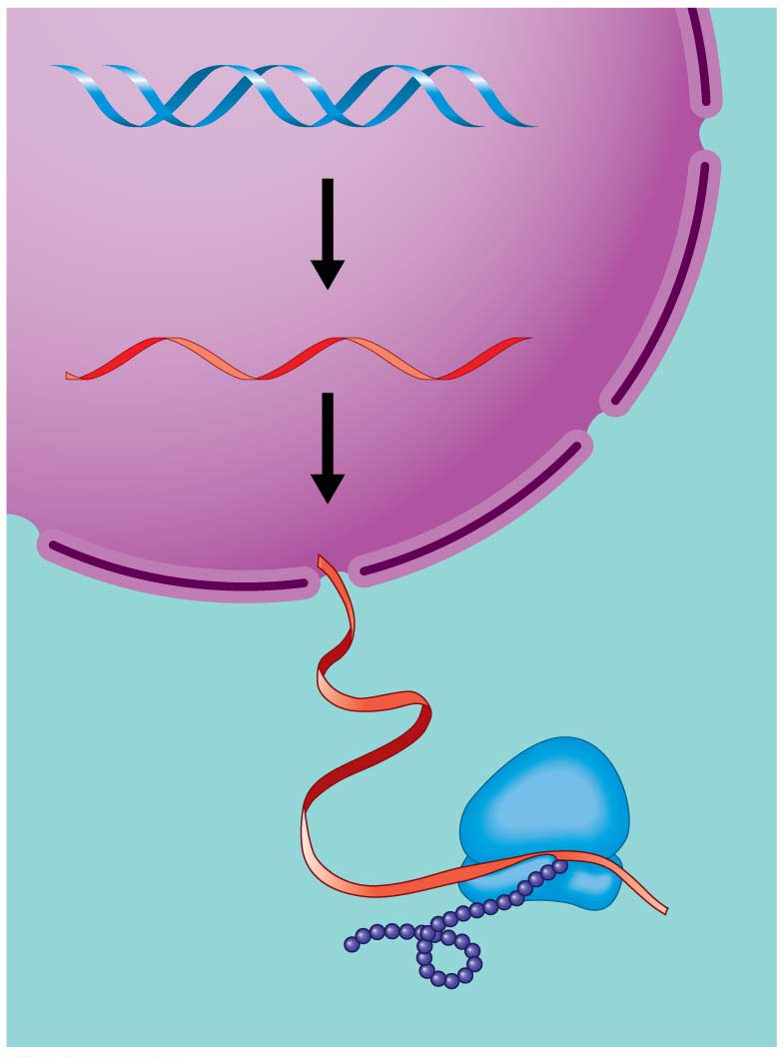
DNA
1
Synthesis of
mRNA in the
nucleus
mRNA
Nucleus
Cytoplasm
2
Movement of
mRNA into
cytoplasm via
nuclear pore
mRNA
Ribosome
3
Synthesis of
protein in the
cytoplasm
Protein

Slide 44
The Endomembrane System: Manufacturing and Distributing Cellular Products
The endomembrane system（内膜系统） in a cell consists of
the nuclear envelope,
the endoplasmic reticulum,
the Golgi apparatus,
lysosomes, and
vacuoles.
endo = inner (endomembrane system: an internal system of membranous organelles)
Notes:
44

Slide 45
The Endomembrane System: Manufacturing and Distributing Cellular Products
These membranous organelles are either
physically connected or
linked by vesicles（囊泡）, sacs made of membrane.
Notes:
45

Slide 46
The Endoplasmic Reticulum
The endoplasmic reticulum (ER) is one of the main manufacturing facilities in a cell.
The ER
produces an enormous variety of molecules,
is connected to the nuclear envelope, and
is composed of interconnected rough and smooth ER that have different structures and functions.
reticul = network (endoplasmic reticulum: membranous network where proteins are produced)
Notes:
46

Slide 47
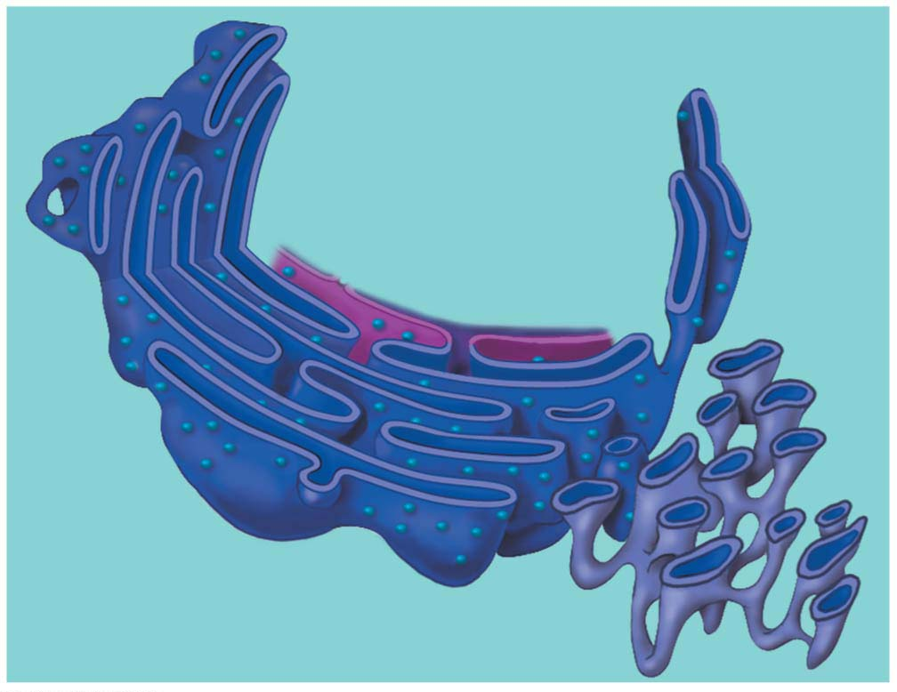
Nuclear
envelope
Ribosomes
Rough ER
Smooth ER
Notes:
Figure 4.11 The endoplasmic reticulum (ER)

Slide 48
Rough ER
The “rough” in rough ER refers to ribosomes that stud the outside of its membrane.
The ER makes more membrane.
Ribosomes attached to the rough ER produce proteins that will be
inserted into the growing ER membrane,
transported to other organelles, and
eventually exported.
Notes:
48

Slide 49
Rough ER
Some products manufactured by rough ER are chemically modified and then packaged into transport vesicles, sacs made of membrane that bud off from the rough ER.
Then these transport vesicles may be dispatched to other locations in the cell.
Notes:
49

Slide 50
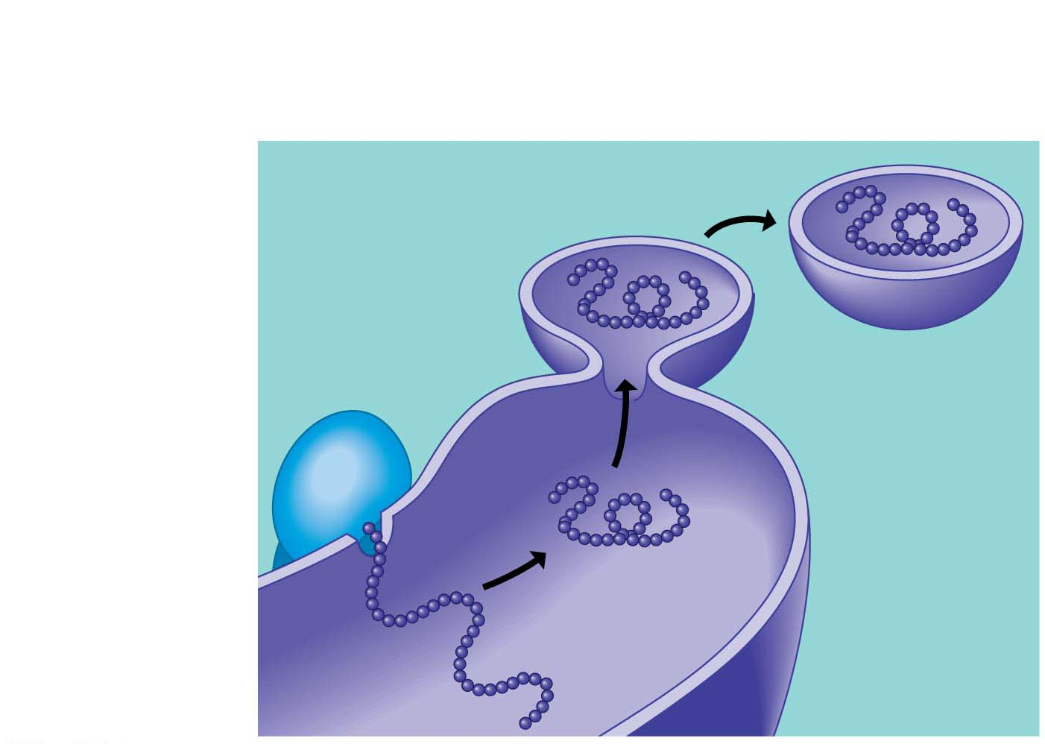
3
Secretory
proteins depart.
4
Vesicles bud off
from the ER.
2
Proteins are
modified in
the ER.
Transport
vesicle
Ribosome
1
A ribosome
links amino
acids.
Protein
Rough ER
Polypeptide
Notes:
Figure 4.12 How rough ER manufactures and packages secretory proteins

Slide 51
Smooth ER
The smooth ER
lacks surface ribosomes,
produces lipids, including steroids（类固醇）, and
helps liver cells detoxify circulating drugs.
Notes:
51

Slide 52
The Golgi Apparatus
The Golgi apparatus
works in partnership with the ER and
receives, refines, stores, and distributes chemical products of the cell.
Notes:
52

Slide 53
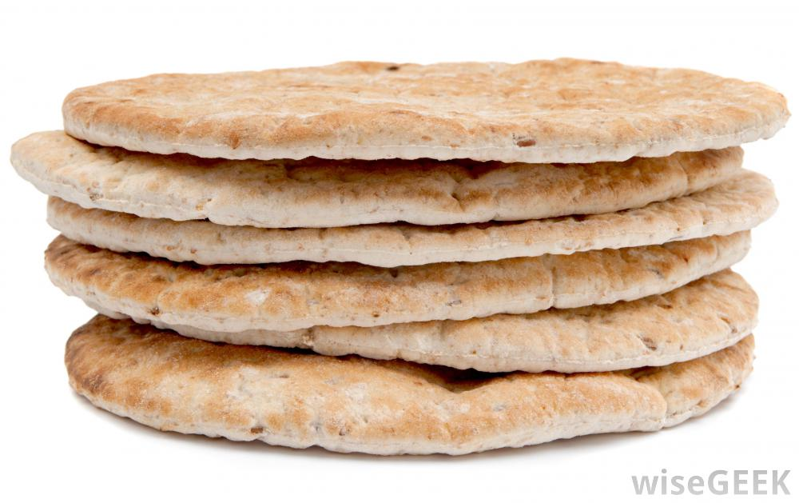
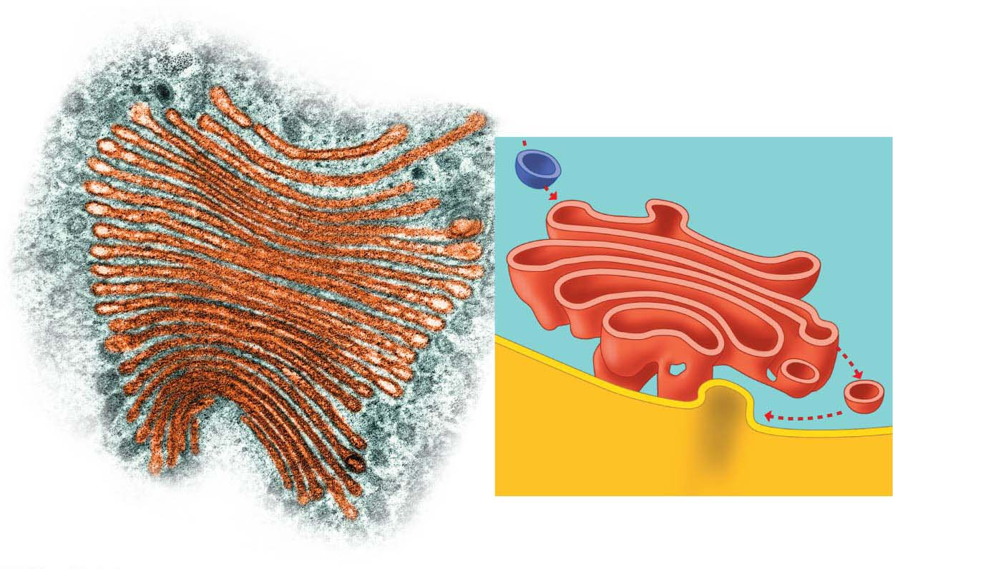
“Receiving” side of the
Golgi apparatus
Pita bread
Transport vesicle
from rough ER
“Receiving” side of
the Golgi apparatus
1
New
vesicle
forming
2
3
Transport
vesicle
from the
Golgi
apparatus
Colorized SEM
“Shipping” side of
the Golgi apparatus
Plasma
membrane
New vesicle forming
Notes:
Figure 4.13 The Golgi apparatus

Slide 54
The Golgi Apparatus
The Golgi apparatus consists of a stack of membrane plates.
Products made in the ER reach the Golgi apparatus in transport vesicles.
Proteins within a vesicle are usually modified by enzymes during their transit from the receiving to the shipping side of the Golgi apparatus.
The shipping side of a Golgi stack is a depot from which finished products can be carried in transport vesicles to other organelles or to the plasma membrane.
Notes:
54

Slide 55
Lysosomes
A lysosome is a membrane-enclosed sac of digestive enzymes found in animal cells.
Most plant cells do not contain lysosomes.
Enzymes in a lysosome can break down large molecules such as
proteins,
Polysaccharides（多糖）,
fats, and
nucleic acids.
Notes:
55

Slide 56
Lysosomes
Lysosomes have several types of digestive functions.
Many single-celled protists engulf nutrients in tiny cytoplasmic sacs called food vacuoles.
Lysosomes fuse with the food vacuoles, exposing the food to digestive enzymes.
Small molecules that result from this digestion, such as amino acids, leave the lysosome and nourish the cell.
Notes:
56

Slide 57
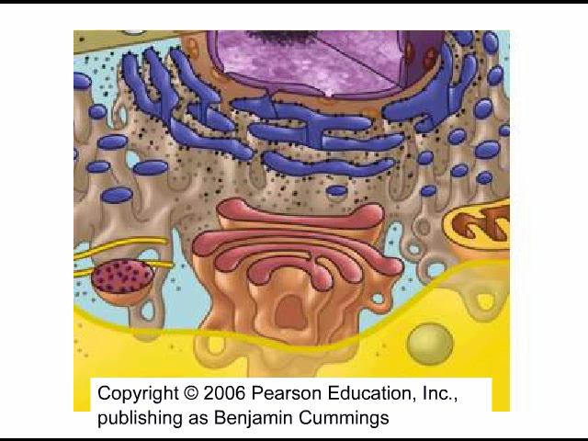
Animation: Lysosome Formation

Slide 58
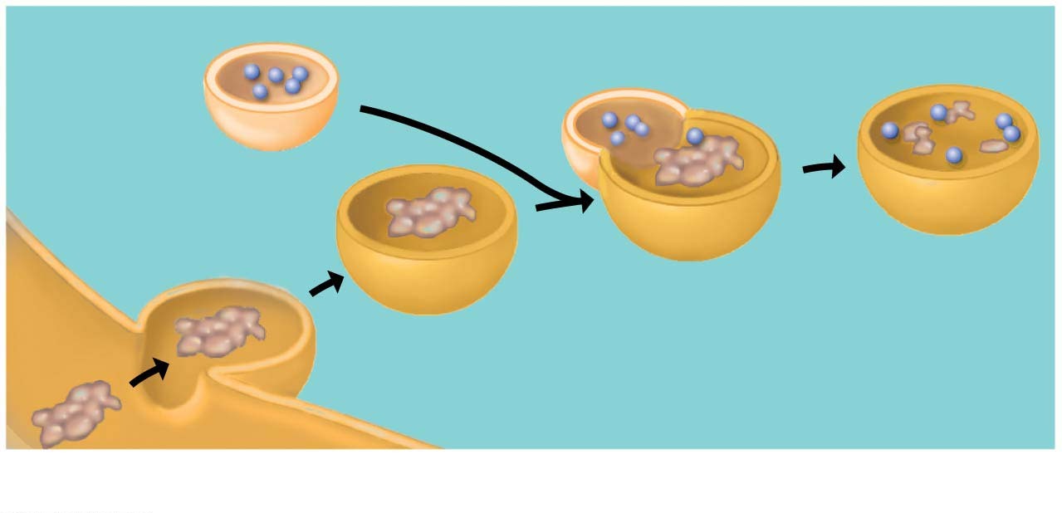
Digestive enzymes
Lysosome
Digestion
Food vacuole
Plasma membrane
(a) A lysosome digesting food
Notes:
Figure 4.14-1 Two functions of lysosomes (part 1: digesting food)

Slide 59
Lysosomes
Lysosomes can also
destroy harmful bacteria,
engulf and digest parts of another organelle, and
sculpt tissues during embryonic development, helping to form structures such as fingers.
Notes:
59

Slide 60
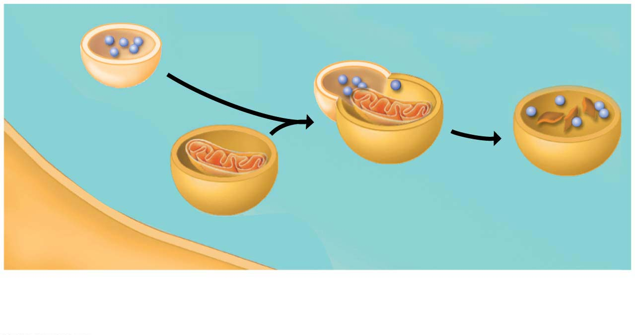
Figure 4.14-2
Lysosome
Digestion
Vesicle containing
damaged organelle
(b) A lysosome breaking down the molecules of
damaged organelles

Slide 61
Vacuoles
Vacuoles are large sacs made of membrane that bud off from the ER or Golgi apparatus.
Vacuoles have a variety of functions. For example,
food vacuoles bud from the plasma membrane and
certain freshwater protists have contractile vacuoles（伸缩泡） that pump out excess water that flows into the cell from the outside environment.
Notes:
61

Slide 62
Vacuoles
A central vacuole can account for more than half the volume of a mature plant cell.
The central vacuole of a plant cell is a versatile compartment that may
store organic nutrients,
absorb water, and
contain pigments（色素） that attract pollinating insects（传粉昆虫） or poisons that protect against plant-eating animals.
Notes:
62

Slide 63
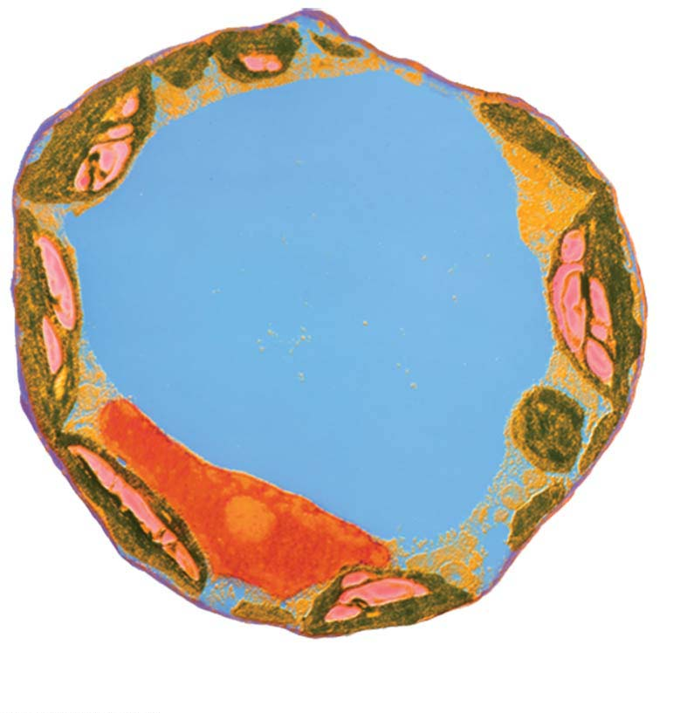
Colorized TEM
Central vacuole
(b) Central vacuole in a plant cell

Slide 64
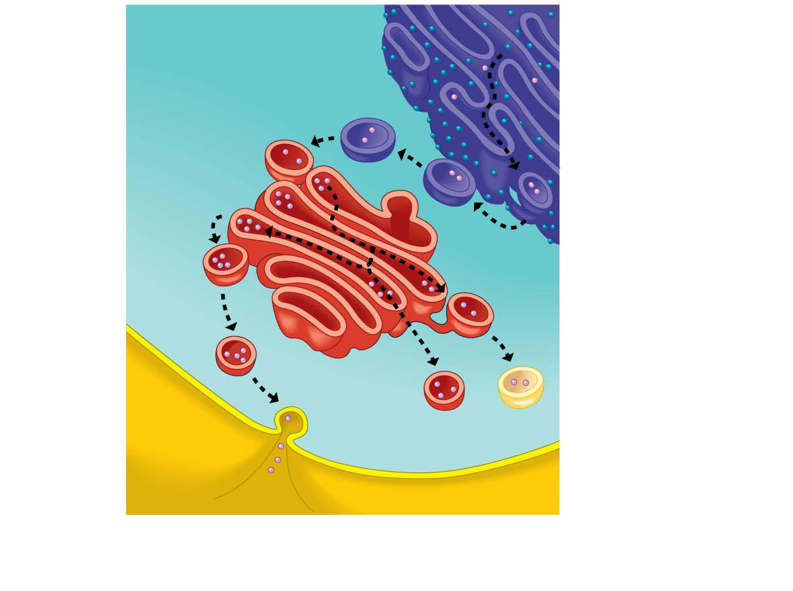
Figure 4.16
Rough ER
Golgi
apparatus
Transport
vesicle
Transport vesicles
carry enzymes and
other proteins from
the rough ER to the
Golgi for processing.
Plasma
membrane
Lysosomes carrying
digestive enzymes
can fuse with other
vesicles.
Secretory
protein
Some products are
secreted from the cell.
Vacuoles store some
cell products.
Notes:
Figure 4.16 Review of the endomembrane system

Slide 65
Energy Transformations: Chloroplasts and Mitochondria
A cell converts energy obtained from the environment to forms that the cell can use directly.
Two organelles act as cellular power stations:
chloroplasts and
mitochondria.
Notes:
65

Slide 66
Chloroplasts
Most of the living world runs on the energy provided by photosynthesis.
Photosynthesis is the conversion of light energy from the sun to
the chemical energy of sugar and
other organic molecules.
Chloroplasts are
unique to the photosynthetic cells of plants and algae and
the organelles that perform photosynthesis.
Notes:
66

Slide 67
Chloroplasts
Chloroplasts are divided into compartments by two membranes, one inside the other.
The stroma（基质） is a thick fluid found inside the innermost membrane.
Suspended in that fluid is a network of membrane-enclosed disks and tubes, which form another compartment.
The disks occur in interconnected stacks called grana（基粒） that resemble stacks of poker chips.
The grana are a chloroplast’s solar power packs, the structures that trap light energy and convert it to chemical energy.
Notes:
67

Slide 68
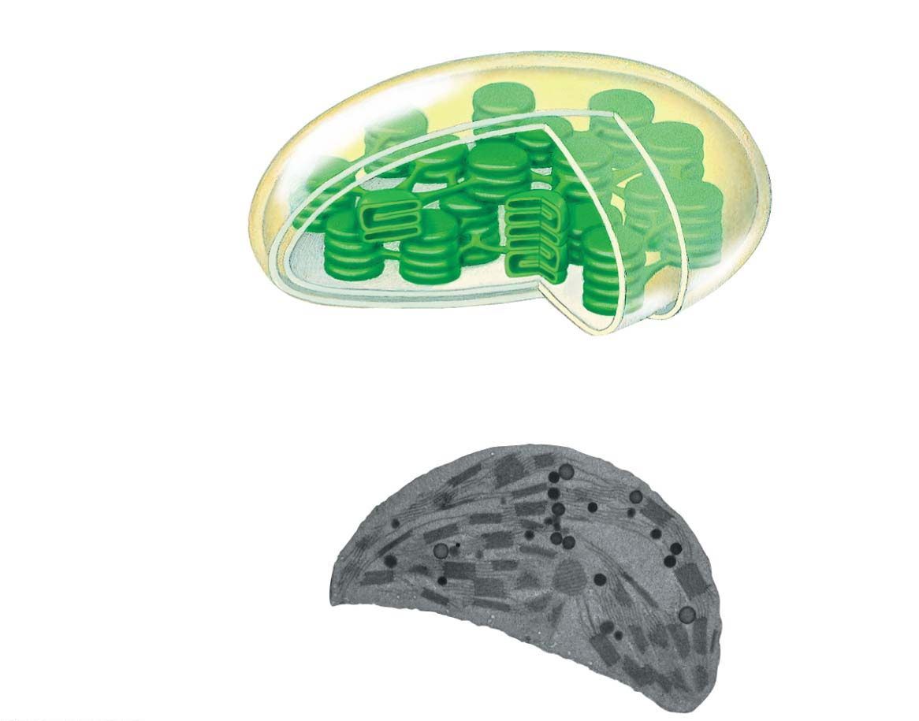
Figure 4.17
Inner and outer
membranes
Space between
membranes
Stroma (fluid in
chloroplast)
Granum
TEM

Slide 69
Mitochondria
Mitochondria
are found in almost all eukaryotic cells,
are the organelles in which cellular respiration（呼吸作用） takes place, and
produce ATP from the energy of food molecules.
Cells use molecules of ATP as the direct energy source for most of their work.
Notes:
69

Slide 70
Mitochondria
An envelope of two membranes encloses the mitochondrion, and the inner membrane encloses a thick fluid called the mitochondrial matrix（基质）.
The inner membrane of the envelope has numerous infoldings called cristae（脊）.
The folded surface of the membrane
includes many of the enzymes and other molecules that function in cellular respiration and
creates a greater area for the chemical reactions of cellular respiration.
Notes:
70

Slide 71
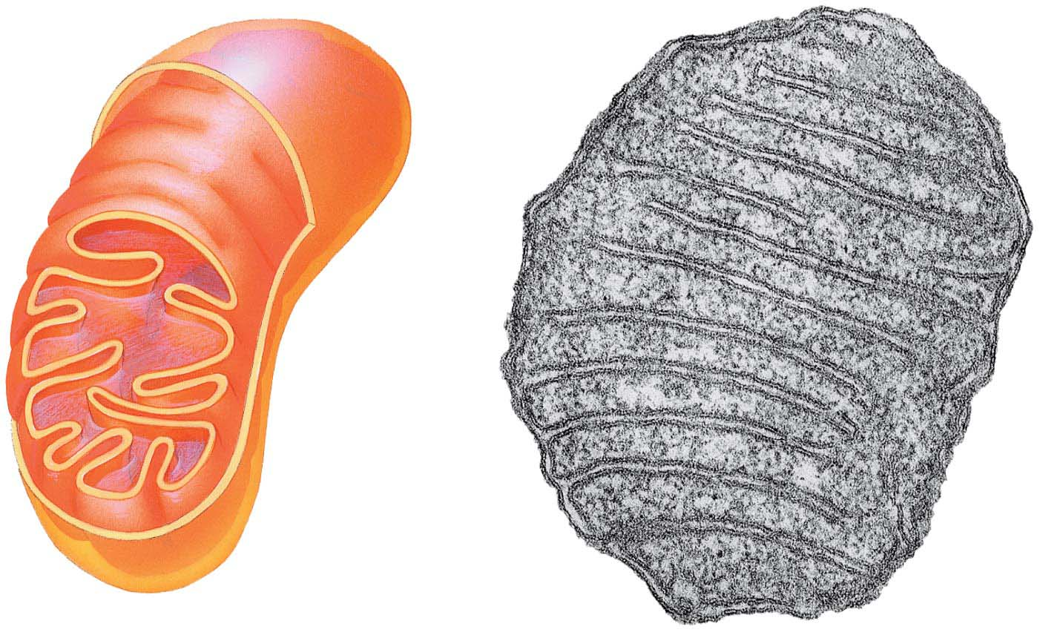
Figure 4.18
Outer
membrane
TEM
Inner
membrane
Cristae
Matrix
Space between
membranes
Notes:
Figure 4.18 The mitochondrion: site of cellular respiration

Slide 72
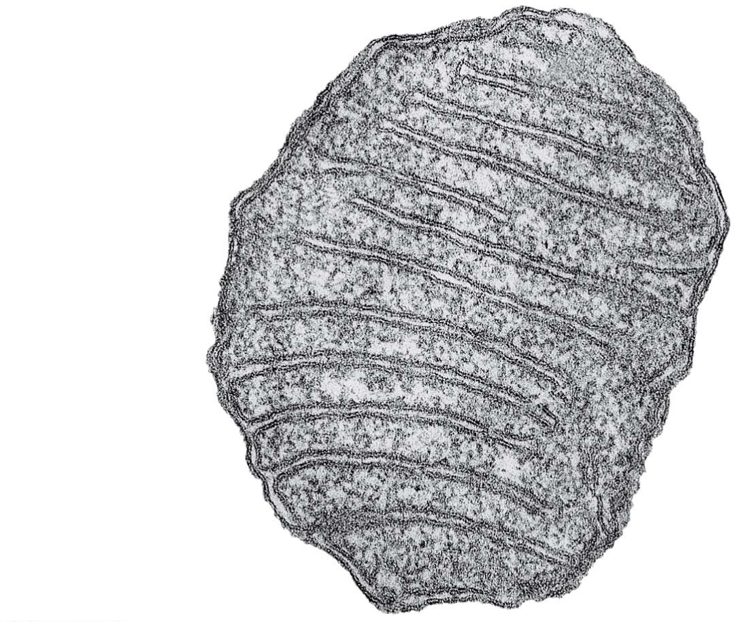
Figure 4.18-1
Outer
membrane
TEM
Inner
membrane
Cristae
Matrix
Space between
membranes
Notes:
Figure 4.18-1 The mitochondrion: site of cellular respiration (part 1: TEM)

Slide 73
Mitochondria
Mitochondria and chloroplasts contain their own DNA that encodes some of their own proteins made by their own ribosomes.
Each chloroplast and mitochondrion
contains a single circular DNA chromosome that resembles a prokaryotic chromosome and
can grow and pinch in two, reproducing themselves.
Notes:
73

Slide 74
Mitochondria
This is evidence that mitochondria and chloroplasts evolved from ancient free-living prokaryotes that established residence within other, larger host prokaryotes.
This phenomenon, where one species lives inside a host species, is a special type of symbiosis（共生关系）.
Over time, mitochondria and chloroplasts likely became increasingly interdependent with the host prokaryote, eventually evolving into a single organism with inseparable parts.
Notes:
74

Slide 75
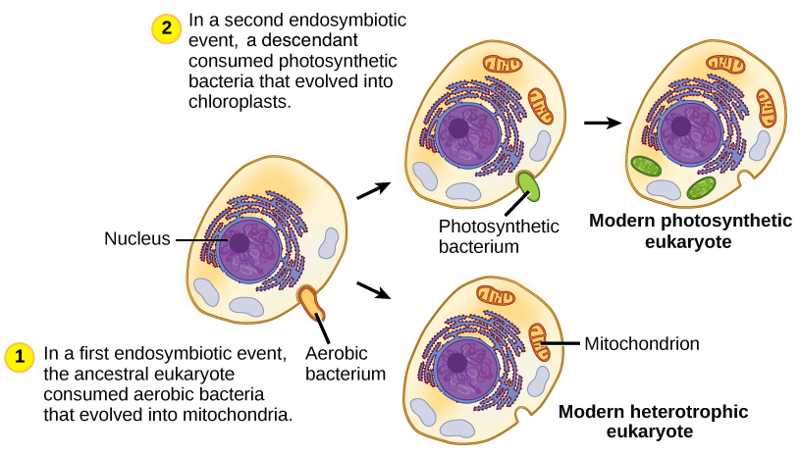
Mitochondria and chloroplasts

Slide 76
The Cytoskeleton: Cell Shape and Movement
The cytoskeleton
is a network of fibers extending throughout the cytoplasm and
serves as both skeleton and “muscles” for the cell, functioning in support and movement.
Notes:
76

Slide 77
Maintaining Cell Shape
The cytoskeleton contains several types of fibers made from different proteins.
Microtubules（微管） are hollow tubes of protein.
The other kinds of cytoskeletal fibers, called intermediate filaments（中间纤维） and microfilaments（微丝）, are thinner and solid.
The cytoskeleton provides anchorage and reinforcement for many organelles in a cell.
Notes:
77

Slide 78
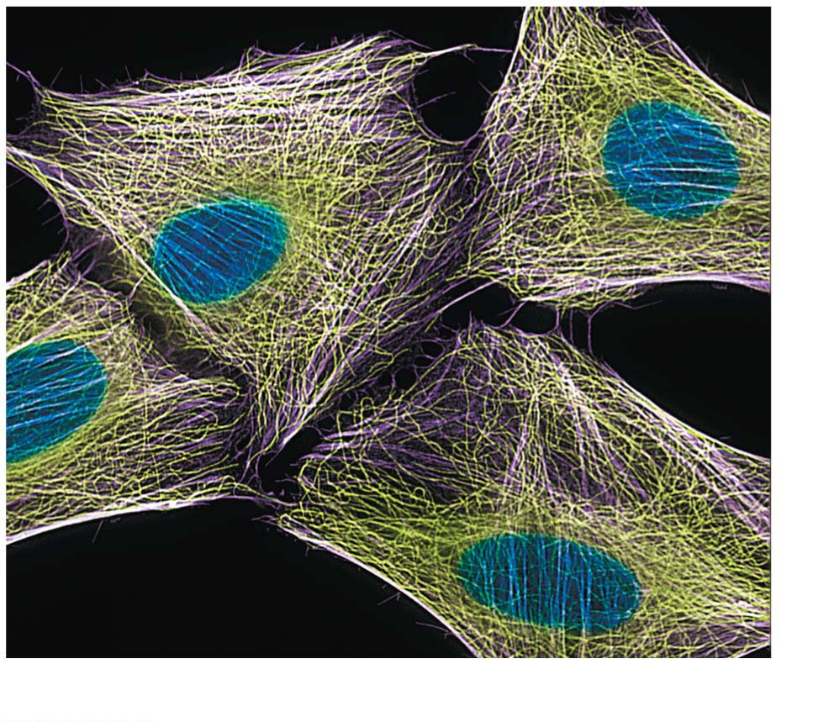
Figure 4.19-1
LM
(a) Microtubules in the cytoskeleton
Notes:
Figure 4.19-1 The cytoskeleton (part 1: microtubules)

Slide 79
Maintaining Cell Shape
A cell’s cytoskeleton is dynamic.
It can be quickly dismantled in one part of the cell by removing protein subunits and re-formed in a new location by reattaching the subunits.
Such rearrangement can
provide rigidity in a new location,
change the shape of the cell,
or even cause the whole cell or some of its parts to move.
Notes:
79

Slide 80
Cilia（纤毛） and Flagella
In some eukaryotic cells, microtubules are arranged into structures called flagella and cilia, extensions from a cell that aid in movement.
Eukaryotic flagella propel cells through an undulating, whiplike motion.
They often occur singly, such as in human sperm cells（精子）, but may also appear in groups on the outer surface of protists.
cili = small hair (cilium: a short, hair like cellular appendage with a microtubule core)
flagell = whip (flagellum: a long, whip like cellular appendage that moves cells)
Notes:
80

Slide 81
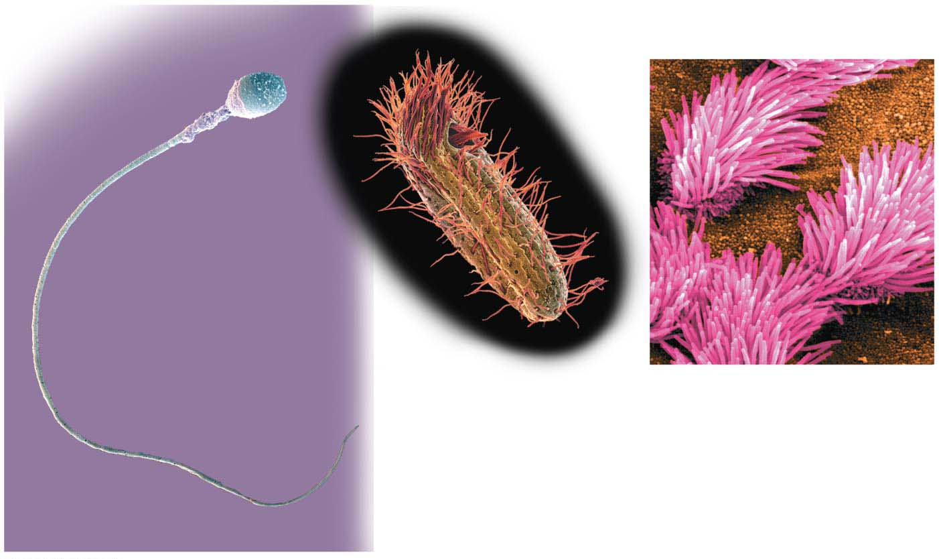
Colorized SEM
Colorized SEM
(a) Flagellum of a
human sperm cell
(b) Cilia on a protist
(c) Cilia lining the respiratory
tract
Colorized SEM
Notes:
Figure 4.20 Examples of flagella and cilia

Slide 82
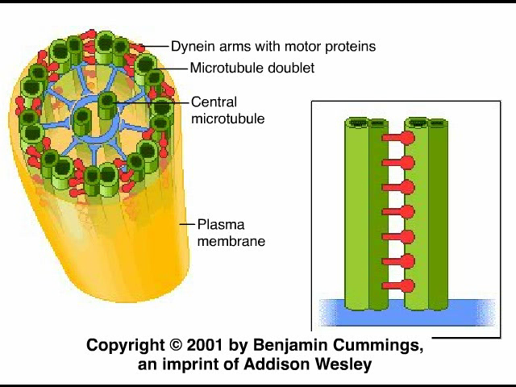
Animation: Cilia and Flagella

Slide 83
Cilia and Flagella
Because human sperm rely on flagella for movement, it is easy to understand why problems with flagella can lead to male infertility（不育症）.
Some men with a type of hereditary sterility（遗传性不育） also suffer from respiratory problems because of a defect in the structure of their flagella and cilia.
Notes:
83

Slide 84
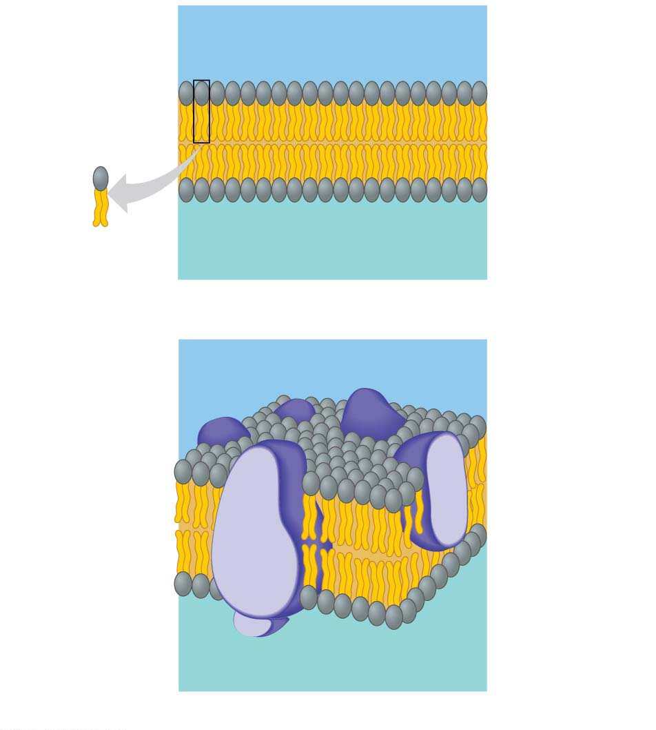
Outside of cell
Hydrophilic
head
Hydrophobic
tail
Phospholipid
Cytoplasm (inside of cell)
(a) Phospholipid bilayer of membrane
Outside of cell
Embedded
proteins
Hydrophilic
head
Phospholipid
bilayer
Hydrophobic
tail
Cytoplasm (inside of cell)
(b) Fluid mosaic model of membrane
Notes:
Figure 4.4 The plasma membrane structure

Slide 85
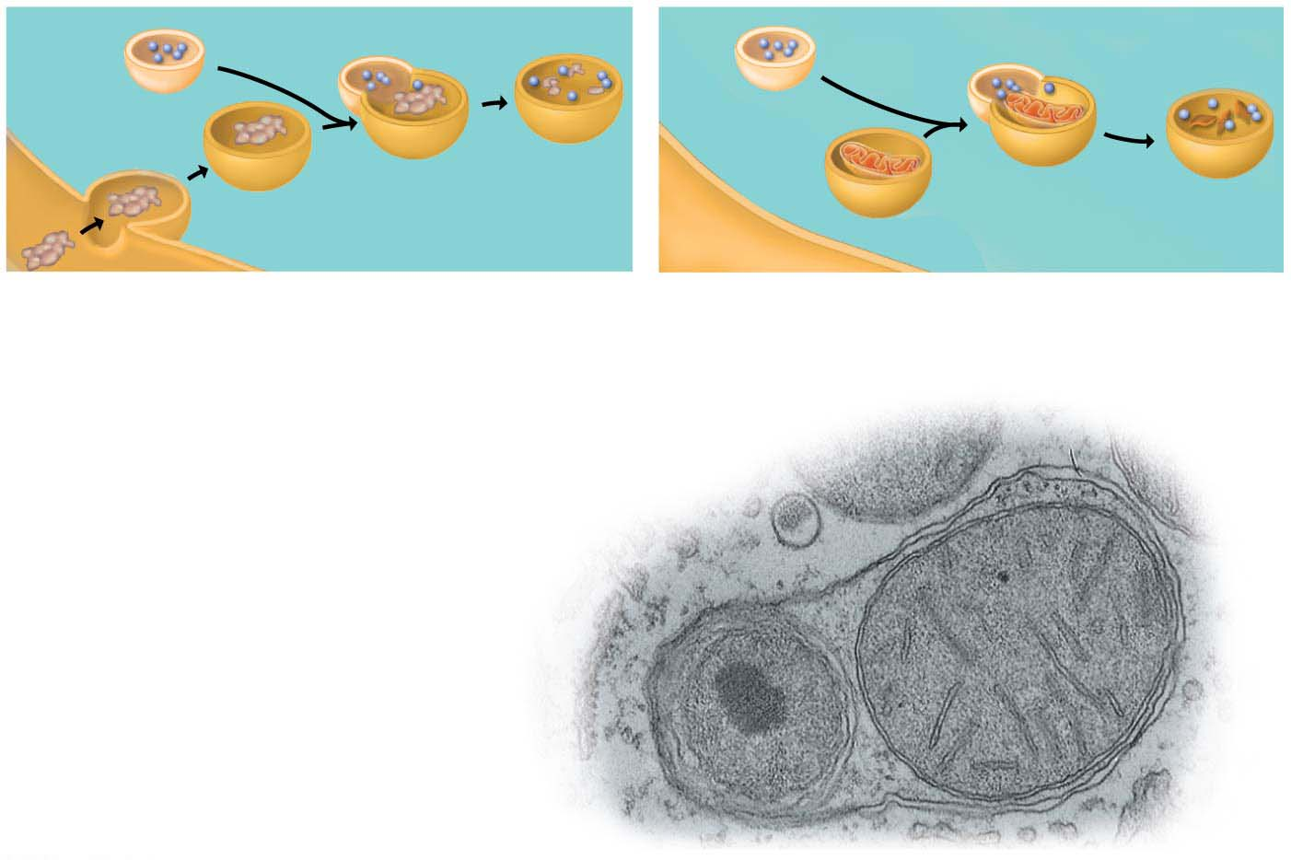
Figure 4.14
Digestive enzymes
Lysosome
Lysosome
Digestion
Food vacuole
Digestion
Vesicle containing
damaged organelle
Plasma membrane
(a) A lysosome digesting food
(b) A lysosome breaking down the molecules of
damaged organelles
Organelle
fragment
Vesicle containing
two damaged
organelles
Organelle
fragment
TEM
Notes:
Figure 4.14 Two functions of lysosomes

Slide 86
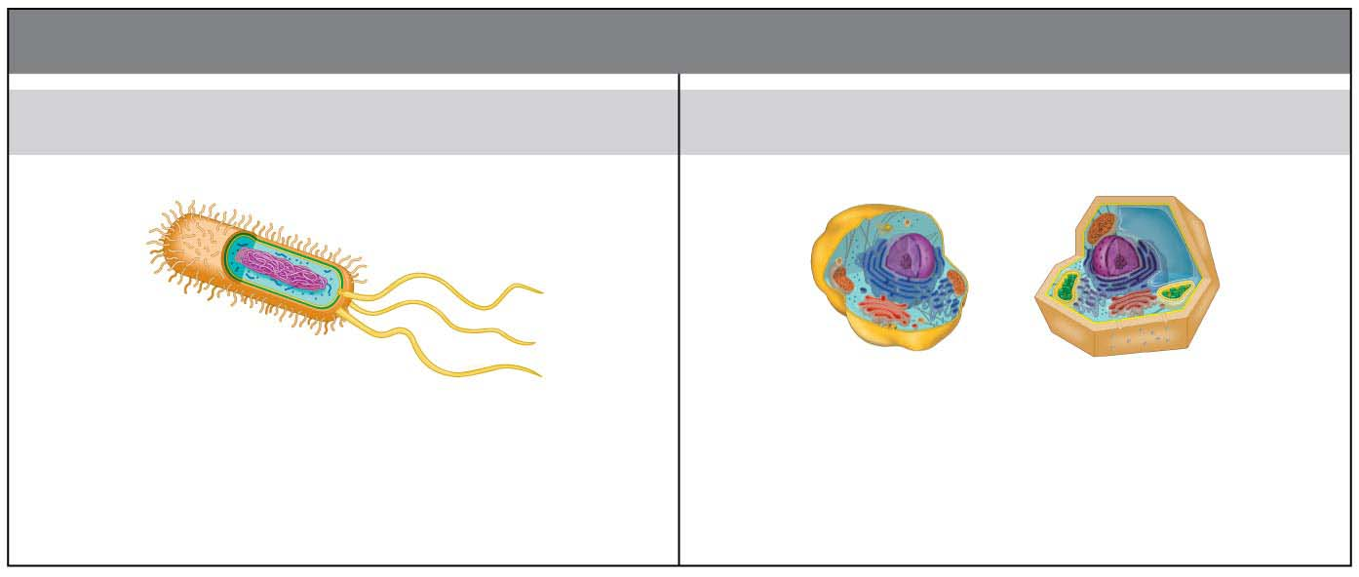
Figure 4.UN11
CATEGORIES OF CELLS
Prokaryotic Cells
Eukaryotic Cells
• Smaller
• Larger
• Simpler
• More complex
• Lack membrane-bound organelles
• Have membrane-bound organelles
• Found in bacteria and archaea
• Found in protists, plants, fungi, animals
Notes:
Figure 4.UN11 Summary of key concepts: cell categories

Slide 87
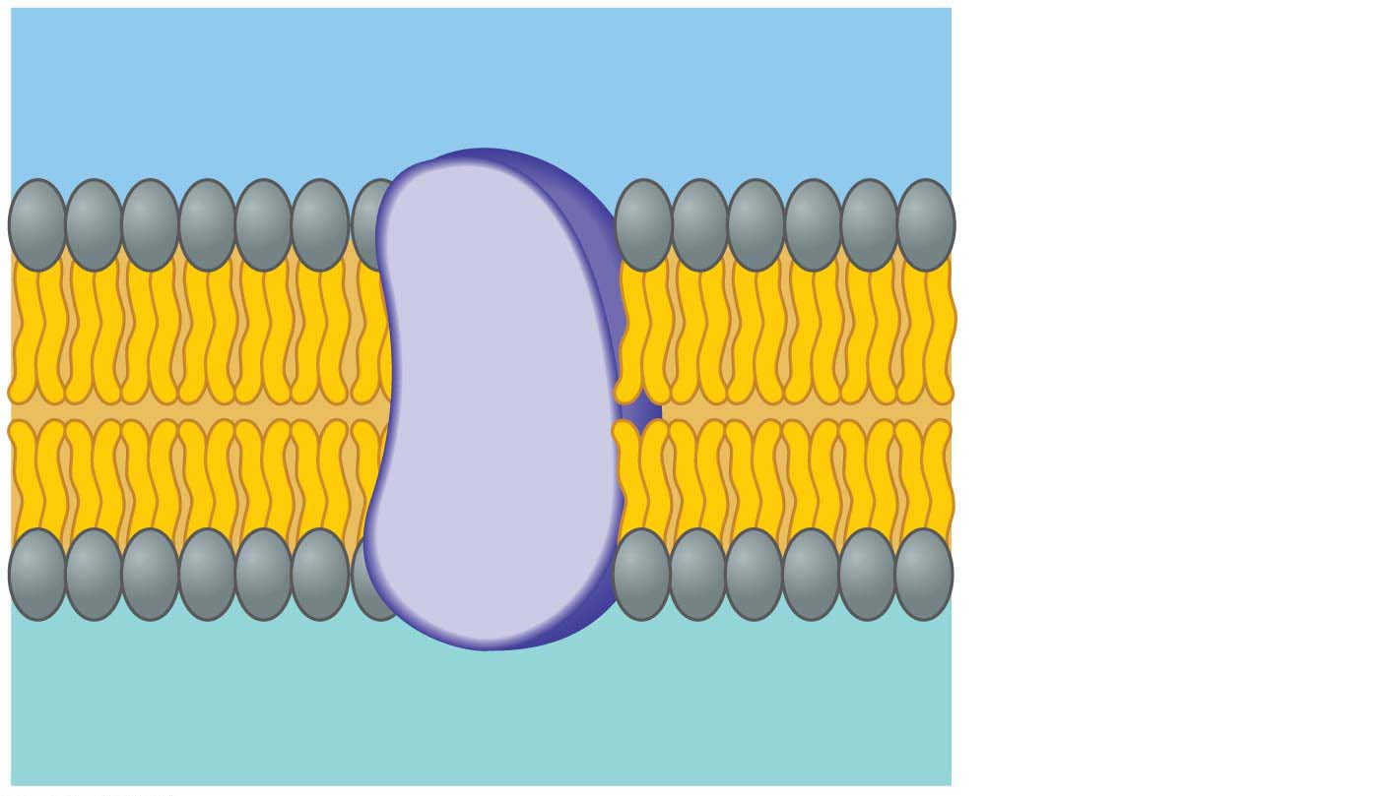
Outside of cell
Phospholipid
Hydrophilic
Protein
Hydrophobic
Hydrophilic
Cytoplasm (inside of cell)
Notes:
Figure 4.UN12 Summary of key concepts: plasma membrane

Slide 88
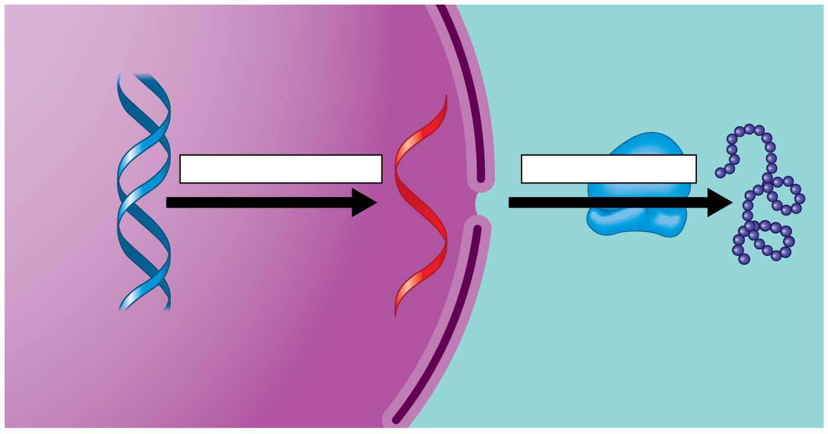
Figure 4.UN13
TRANSCRIPTION
TRANSLATION
Gene
Ribosome
Protein
DNA
mRNA
Nucleus
Cytoplasm
Notes:
Figure 4.UN13 Summary of key concepts: protein production

Slide 89
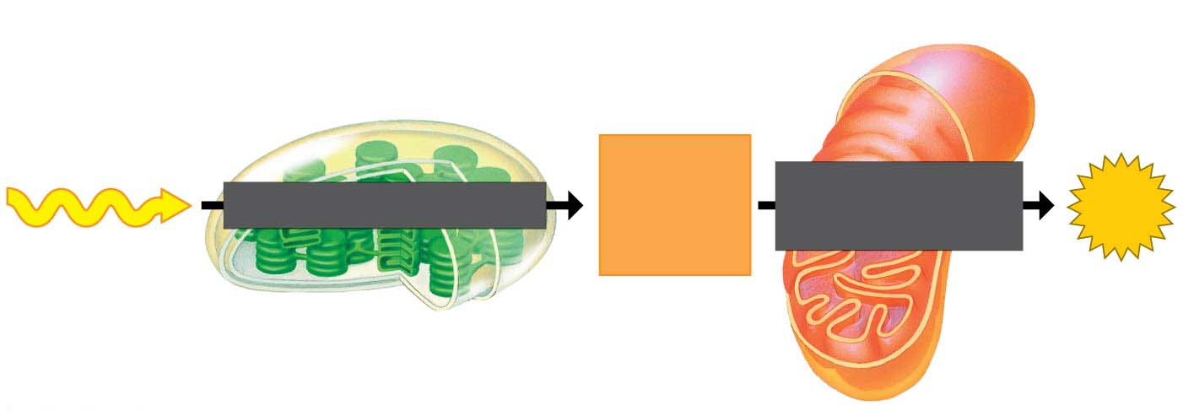
Mitochondrion
Chloroplast
Light energy
Chemical
energy
(food)
PHOTOSYNTHESIS
CELLULAR
RESPIRATION
ATP
Notes:
Figure 4.UN14 Summary of key concepts: chloroplasts and mitochondria

Slide 90
Notes:
https://baike.baidu.com/item/%E9%BB%91%E8%92%99%E6%80%A7%E5%AE%B6%E6%97%8F%E7%97%B4%E5%91%86%E7%97%87/778100

